Slide 1
Predicting Customer Propensity to Subscribe for a Term Deposit
By SHAIK RIYAZ

Slide 2

Mission statement:
Data-Driven Approach to Optimizing Marketing Campaigns

Slide 3
Project Objective and Business Impact
Primary Goal: Develop a robust predictive model to accurately identify bank clients most likely to subscribe to a term deposit.
Business Impact:
Increase marketing campaign efficiency and ROI by focusing resources on high-propensity leads.
Enable personalized and targeted marketing efforts.
Gain a deeper, data-driven understanding of customer behavior and motivations.
20XX | 20XX | 20XX | 20XX

Slide 4

Source: Banking campaign data with 45,216 records and 19 features, covering client demographics, financial profiles, and campaign interactions.
Target Variable: 'y' - a binary outcome ('yes' or 'no') for term deposit subscription.
Data Preparation Steps:
Initial Loading & Cleaning: Data loaded using pandas extra quotes programmatically stripped from column names.
Target Variable Transformation: 'y' variable converted from categorical ('yes'/'no') to numerical (1/0) for modeling.
Data Integrity: All records preserved; coded values (e.g., pdays = -1) handled strategically within the model pipeline.
Show how you solve the problem yu identified.
What will be different when the problem is solved (by you)?
Understanding the Data & Building a Foundation

Slide 5
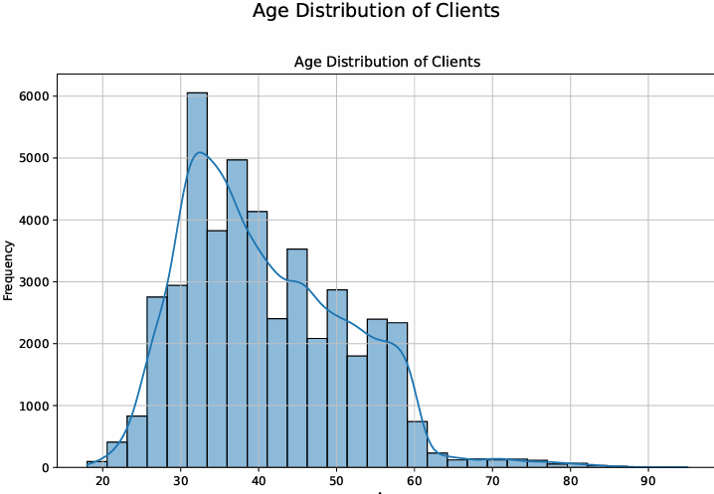
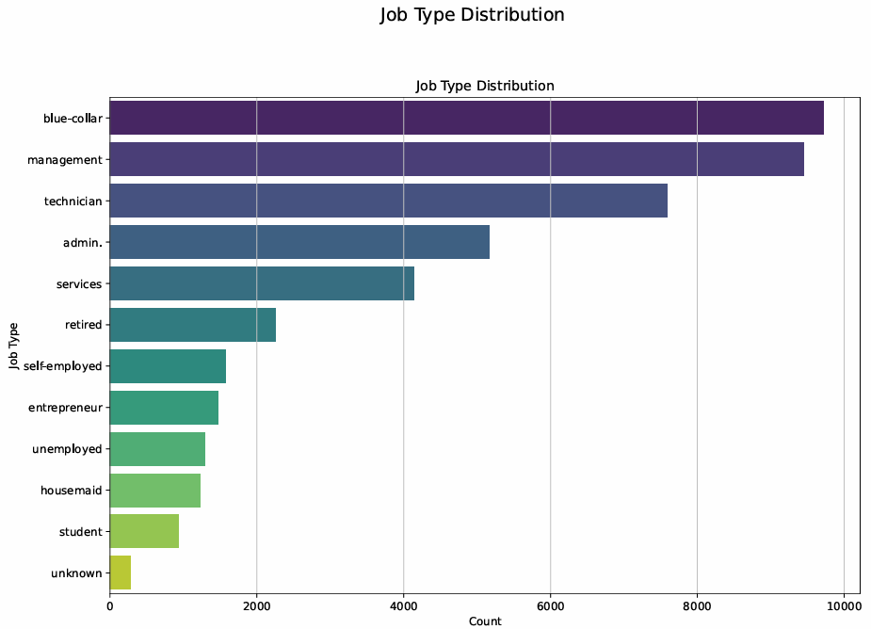
EDA: Who Are Our Clients? (Demographics)
Age: Client base concentrated in the 30-50 age range, with a mean age of ~41 years.
Job Type: Top three professions: Blue-collar (21.5%), Management (20.9%), and Technician (16.8%).

Slide 6
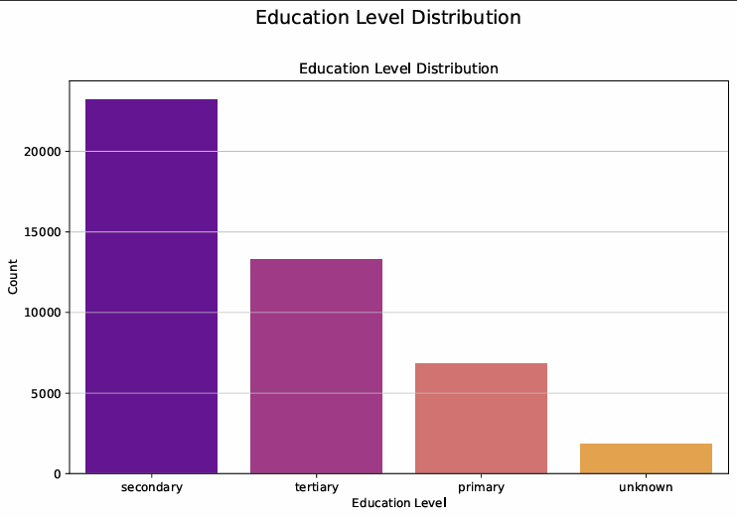
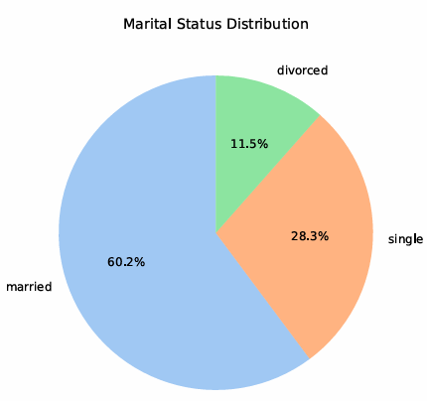
EDA: Who Are Our Clients? (Demographics)
Marital & Education Status:
Majority of clients are married (60.2%).
Single clients are 28.3% and 11.5% are divorced clients .
Over half have completed secondary education (51.3%).

Slide 7
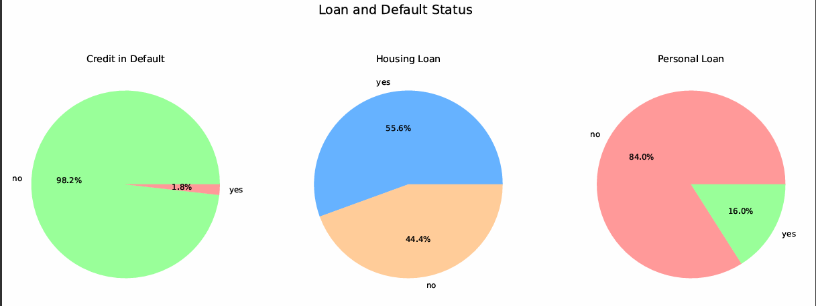
EDA: Financial Profile of Clients
Loan Status: Significant portion of clients (55.6%) have a housing loan; only 16.0% have a personal loan.
Credit History: Client base is financially responsible; overwhelming majority (98.2%) have no credit in default.

Slide 8
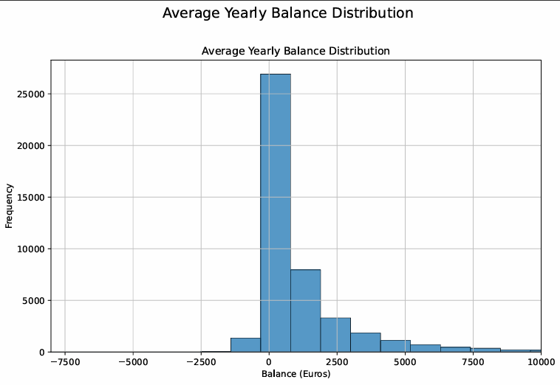
EDA: Financial Profile of Clients
Account Balance: Average yearly balance is €1,362; median is much lower at €448, indicating right-skewed distribution due to a smaller number of clients with very high balances.

Slide 9
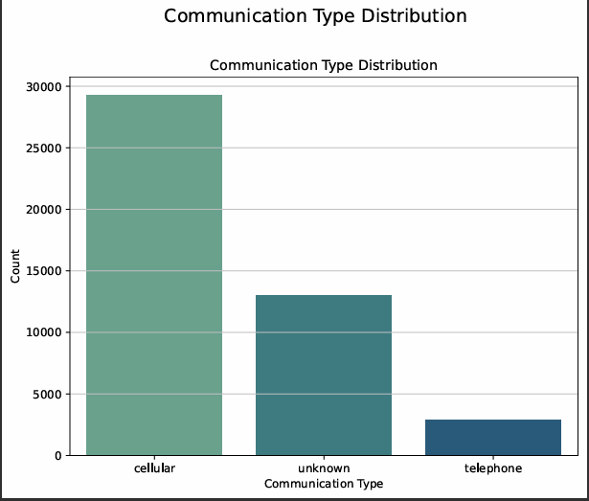
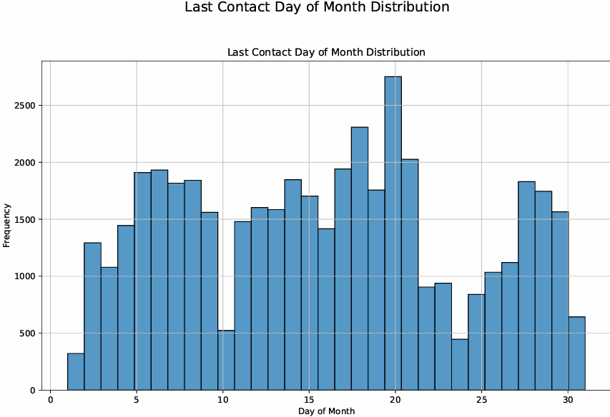
EDA: Analyzing Campaign Interactions
Contact Method: Most contacts via cellular (64.8%), reflecting modern communication preferences.
Campaign Timing: Marketing activity peaks significantly in May, with secondary peaks in July and August, suggesting seasonal campaign pushes.

Slide 10
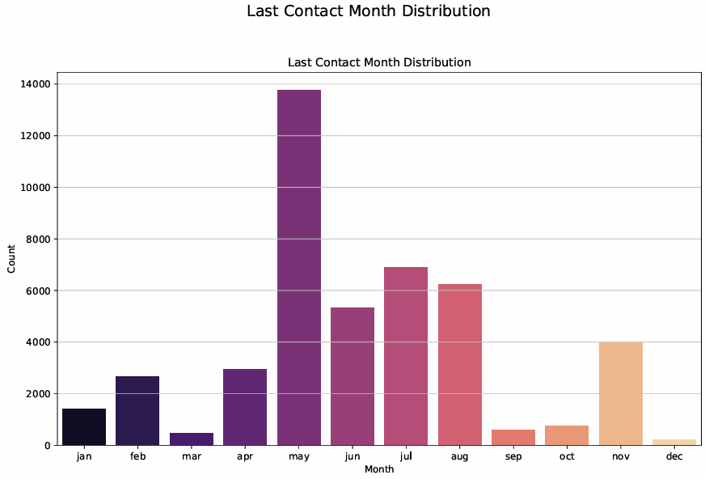
EDA: Analyzing Campaign Interactions
Call Duration: Average call lasts ~4.3 minutes (258 seconds), a powerful predictor of success.

Slide 11
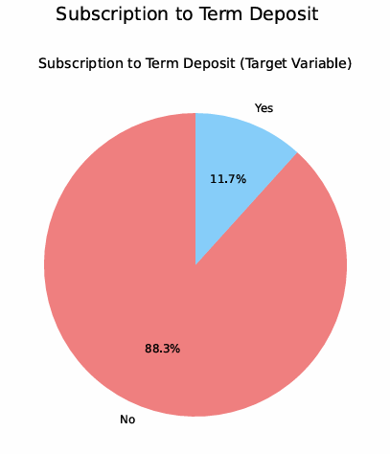
EDA: The Challenge of Class Imbalance
The Outcome: Who Subscribes?
The Core Challenge: The dataset is highly imbalanced.
88.3% of clients did NOT subscribe.
Only 11.7% of clients DID subscribe.
Modeling Implication: This imbalance is critical. A naive model could achieve 88.3% accuracy by always predicting "No," but would have zero predictive value. Our approach must account for this.

Slide 12
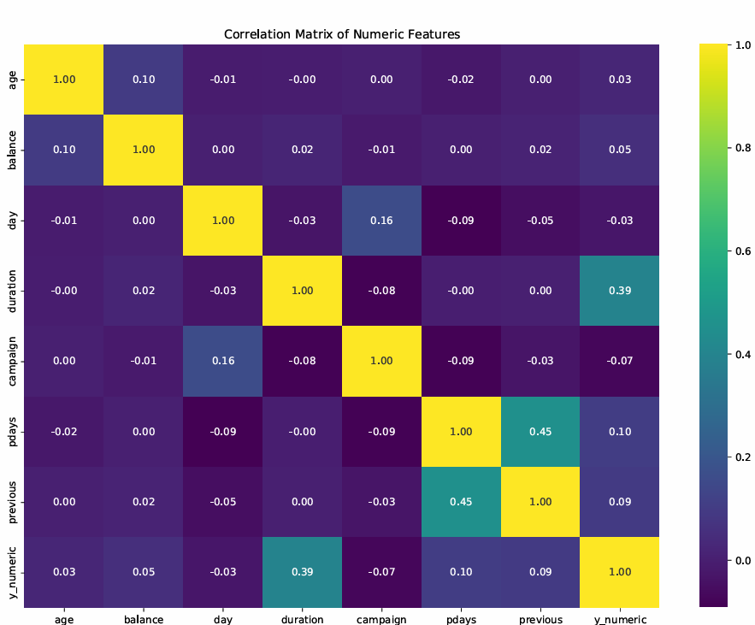
EDA: Correlation Insights
Initial Clues: Correlation Analysis
What it is: A correlation matrix reveals linear relationships between numerical variables.
Key Finding: Duration of the last call has the strongest positive correlation with subscribing (0.39). This was the first statistical clue that conversation length is a key indicator of interest.
Other Correlations: pdays (days since last contact) and previous (number of previous contacts) also show a positive, albeit weaker, correlation with subscription.

Slide 13
An Automated Workflow for Feature Engineering
Technology: Scikit-learn Pipeline used to create a robust, repeatable, and error-free workflow.
Feature Preprocessing: ColumnTransformer used to prepare data for the model:
Numerical Features (age, balance): Scaled using StandardScaler to normalize ranges and prevent bias.
Categorical Features (job, marital): Converted to numerical format using OneHotEncoder for model interpretation.
Key Advantage: This pipeline prevents data leakage and ensures consistency between training and testing.
Show how you solve the problem yu identified.
What will be different when the problem is solved (by you)?
Building the Model: Pipeline & Preprocessing

Slide 14
Model Selection, Training, & Validation
The Engine: Random Forest Classifier
Model Choice: Random Forest algorithm selected due to high performance, robustness against overfitting, and ability to provide feature importance scores.
Handling Imbalance: Model configured with class_weight='balanced' to automatically give more importance to the minority class (subscribers), directly addressing the core data challenge.
Training & Validation:
Data split 80% for training and 20% for testing.
Stratification used to ensure identical 11.7% subscription rate in both sets, critical for valid evaluation.

Slide 15
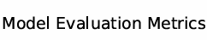
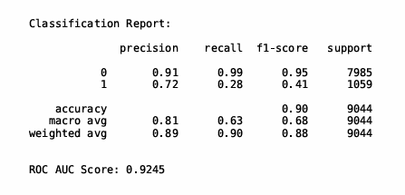
Model Evaluation: The Results
Predicting Success: Our Model's Performance
Model: Random Forest Classifier
Key Performance Metric (ROC AUC Score): 0.92
Indicates excellent ability to distinguish between subscribers and non-subscribers (0.5 is random chance, 1.0 is perfect).
Classification Report:
Exceptional at identifying non-subscribers (91% precision, 99% recall).
Correctly identifies actual subscribers 72% of the time it makes a positive prediction (precision) and finds 28% of all actual subscribers (recall). This trade-off is expected and acceptable given severe class imbalance.

Slide 16
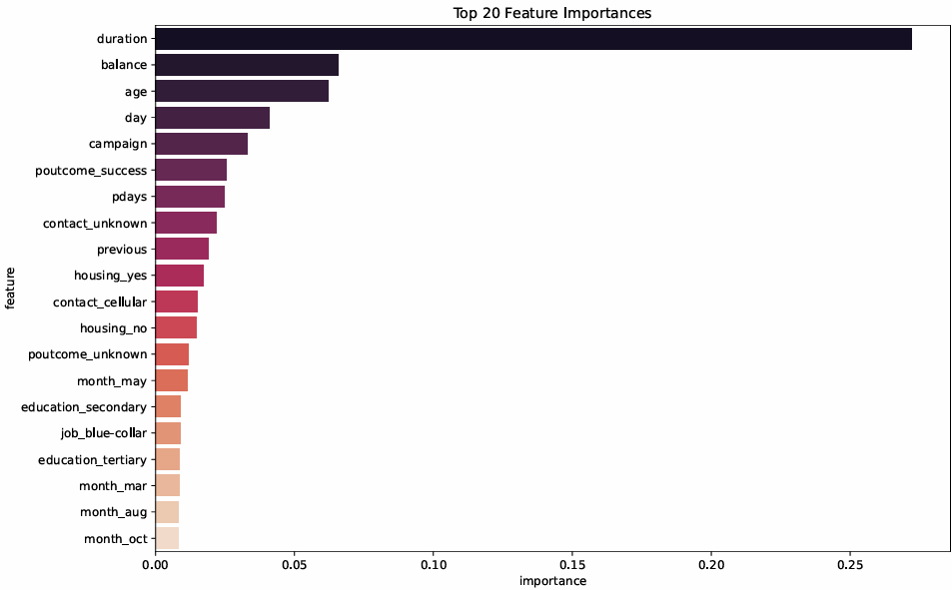
Understanding the "Why": Feature Importance
What Truly Drives Subscriptions?
Random Forest model allows us to see which factors had the most impact on its predictions.
Top 3 Predictors:
Duration (27.2%): The single most dominant feature. Longer, more engaging conversations are the top indicator of client interest.
Balance (6.6%): Clients with higher account balances are more likely to subscribe.
Age (6.2%): Client age is a key demographic factor.
Other Key Factors: A successful outcome in a previous campaign and the number of days since the last contact (pdays) are also highly influential.

Slide 17
Business Insights
Translating Data into Business Strategy
Insight 1: Engagement over Everything. Call duration is more predictive than any demographic or financial attribute, suggesting quality of interaction is paramount.
Insight 2: Past Success Breeds Future Success. Clients who responded positively to past campaigns (poutcome_success) are valuable for future targeting.
Insight 3: Financial Health Matters. Clients with higher balances are more likely to invest, a data-backed intuitive

Slide 18

Thank You
By
Shaik Riyaz
www.linkedin.com/in/shaik-riyaz-761545251

